Slide 1
Analyst Task
Complimentary presentation

Slide 2
Profitability
Profitability Target – 150% Deposit-to-Cost Ratio
Hitting or above Target:
Campaign 1
Campaign 4
Campaign 5
Campaign 6* – not held in Nov
Need attention:
Campaign 1* - hit target
Campaign 2
Campaign 3
Campaign 7
Notes:
Campaign 1: 155%
Campaign 2: 139%
Campaign 3: 112%
Campaign 4: 253% - overachiever
Campaign 5: 212% - overachiever
Campaign 6: 335% - only 3 months - overachiever
Campaign 7: 132 %
Deposit-to-Cost KPI shows the ratio of the average client deposit to the average client cost.
Client cost is calculated when the campaign cost for a given period is divided by the number of clients for the same period.
Since no information about it, 150% Deposit-to-Cost Ratio will be considered as the sufficient minimum to mark a Campaign as profitable => this will be the main KPI’s target.
Astonishing performance of Campaign 6 overachieving the target more than 2x.
However, the fact it was held only 3 out of 4 months leads to the belief that its performance would be in the 240% – 260% range if it was held all the four months, which is comparable to the other overachievers.
Therefore Campaign 4 can be confidently named as most successful being held all four months and showing outstanding performance in each one of them.
Campaign 5 is the runner-up showing consistent performance MoM except Jan 2022 when a 23% decline marked its performance and February not allowing it to compensate following with a trend for all overachievers to experience significant setbacks.
Marked as needing attention are all campaigns that didn’t hit target and/or didn’t show the needed consistent upward performance throughout the months.
Campaign 1 is the noticeable one in this context, as despite it achieves the overall target, its MoM performance is showing unreliable inconsistency. Since January 2022 an improvement can be noticed, however further information (if any) on following months’ performance will show us if the improvement is consistent or was just part of the fluctuating trend of the campaign.
The ones needing attention the most are Campaigns 2 and 3 with Campaign 3 not only below target but consistently struggling to achieve more than the 100s %.
February 2022 is showing huge increase in performance for the usually underachieving campaigns and significant decrease for the usual overachievers, hence why in the bigger context, it can be considered an outlier.
For reasoning, more information is needed such as:
Regions
Communication channels
Leads:
Target persona groups
# Leads who accepted meeting/call
# Leads who declined meeting/call
# Leads who didn't respond

Slide 3
Efficiency
Efficiency – measured by the % conversion of Leads to Clients
Possibility of a lead to become a client:
Campaign 1 – 1 in 30 leads becomes a client
Campaign 2 and 3 – 1 in 45
Campaign 4 – 1 in 58 leads would deposit
Campaign 5 – 1 in 37
Campaign 6 – 1 in 67
Campaign 7 – 1 in 43
Evidence of quality over quantity (depending on the goal)
Notes:
Efficiency target would depend on company’s focus – quantity of clients or quality of clients.
If client quantity is the primary focus the lead-client conversion target should be set in such a way, so that it can stimulate Sales Reps to persuade higher ratio of the metric. In this case the metric would be a separate KPI, independent from the Profitability KPI.
If the primary focus is on the quality of clients i.e. people who can make bigger deposits, the lead-to-client conversion metric should be observed in the context of the Profitability KPI, as it would provide a better overview. This would also isolate the observer from determining a Campaign to be inefficient due to its low conversion rate, since the latter would be compensated by higher deposit-to-cost per client ratio.
The abovementioned is confirmed namely by the observations of the current slide, taking into consideration the previous one.
Namely, we can notice that the campaigns with low or decent profitability – Campaigns 1, 2, 3 and 7 – have higher conversion rate than the Profitability KPI overachievers.
The following suggestions can be derived from this:
Campaigns 1, 2, 3 and 7 were focused on user expansion a.k.a. client quantity or were broadcasted throughout target persona groups with not significant wealth.
The opposite can be said for the overachievers – Campaigns 4, 5*, 6 – focused on client quality, perhaps with wealthier target persona groups. * Campaign 5 is being a positive outlier of the trend by performing consistently well in terms conversion.

Slide 4
Efficiency / Profitability
Overview of leads-to-clients conversion metric in context of the Profitability KPI and Target
In this context the campaigns that pass Profitability Target and have relatively high conversion rate would be considered efficient.
For better assessment ranking systems can be introduced:
Ranking Conversion rate from 1.0 to 5.0
Ranking Profitability performance from 1.0 to 5.0
Overall Efficiency score taking in consideration both assessments

Slide 5
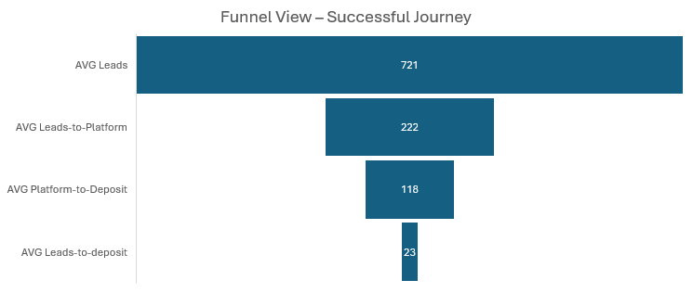
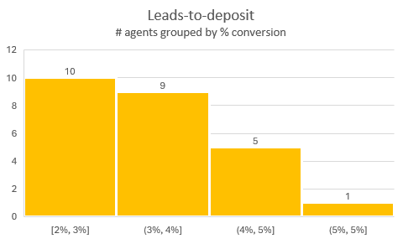
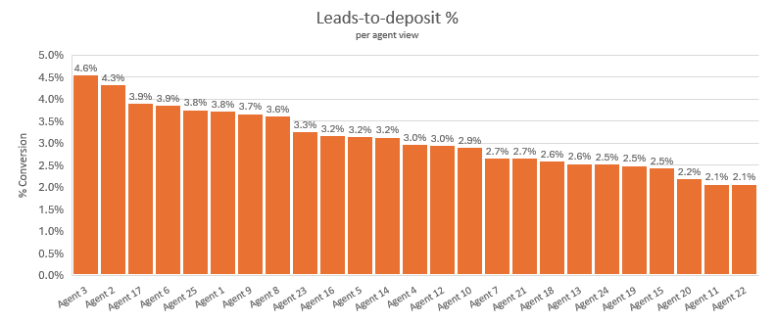
Sales Overview
Funnel View with Averages showing the narrowing of leads to become clients
31% (222) of Leads log into the Platform or 1 in 3 people
54% (118) of them will log into the Deposit page or 1 in 2
19% (23) of those who got to the Deposit page will make a successful deposit or 1 in 5
On average – 3 % of all Leads will deposit successfully
40% of the agents have conversion rate at or below 3%

Slide 6
Sales - Deeper look
Relatively even distribution of leads per agent
No definitive conclusion could be made, based on the currently available data
No significant patterns observed
Notes:
Since no information available, as a target for the Leads-to-deposit % conversion KPI will be accepted the average of all agents – 3%.
Looking at the number of leads per agent, it is noticeable the relatively flat distribution with an average of 721 leads per agent. However, the conversion rate of a lead-to-a-client, presented this way, clearly points out the agents below target and the ones hitting or overachieving it.
Observation of the underperformers at first glance shows no significant difference in the number of leads compared to the rest. Observing the average ratio of leads who log into the platform does not provide any significant insight on the underperformers as well, neither does the observation of leads who failed to deposit.
Having all this in mind, presumptions could be made but not definitive conclusions due to the lack of details.
One such presumption could be that the underperformers were contacting leads without significant ability to make deposit.
More information on the regions, target persona groups, eventual links with the marketing campaigns could provide more insights.

